Slide 1
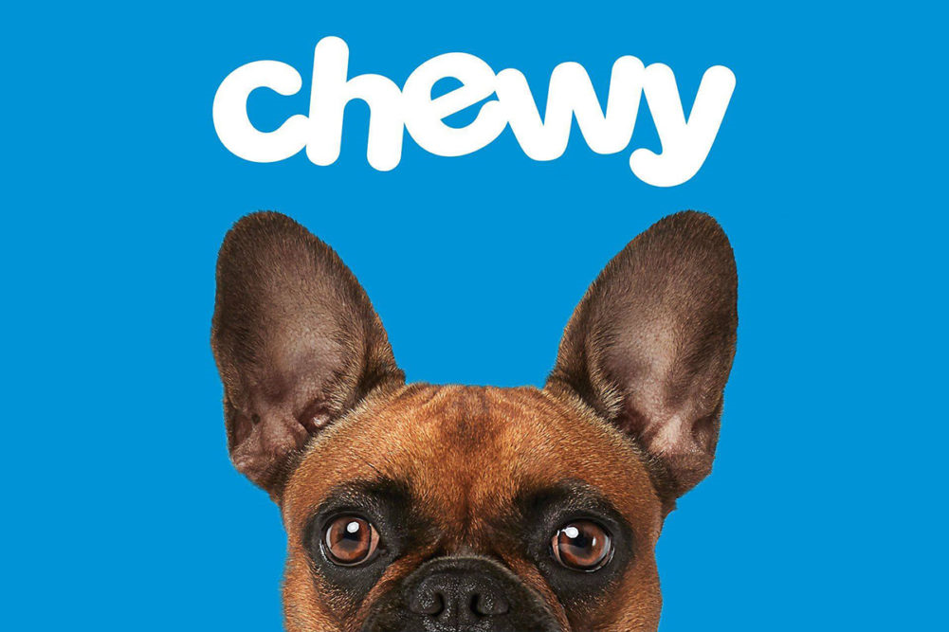
Chewy Q1-Q2 Performance Data

Slide 2

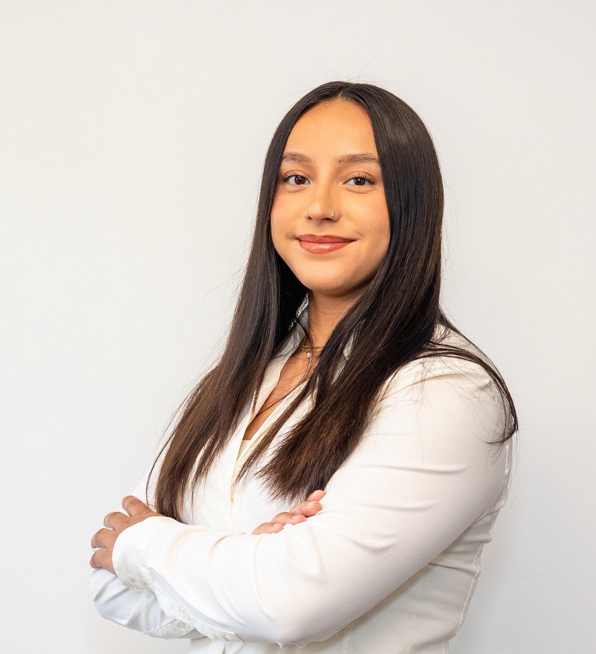


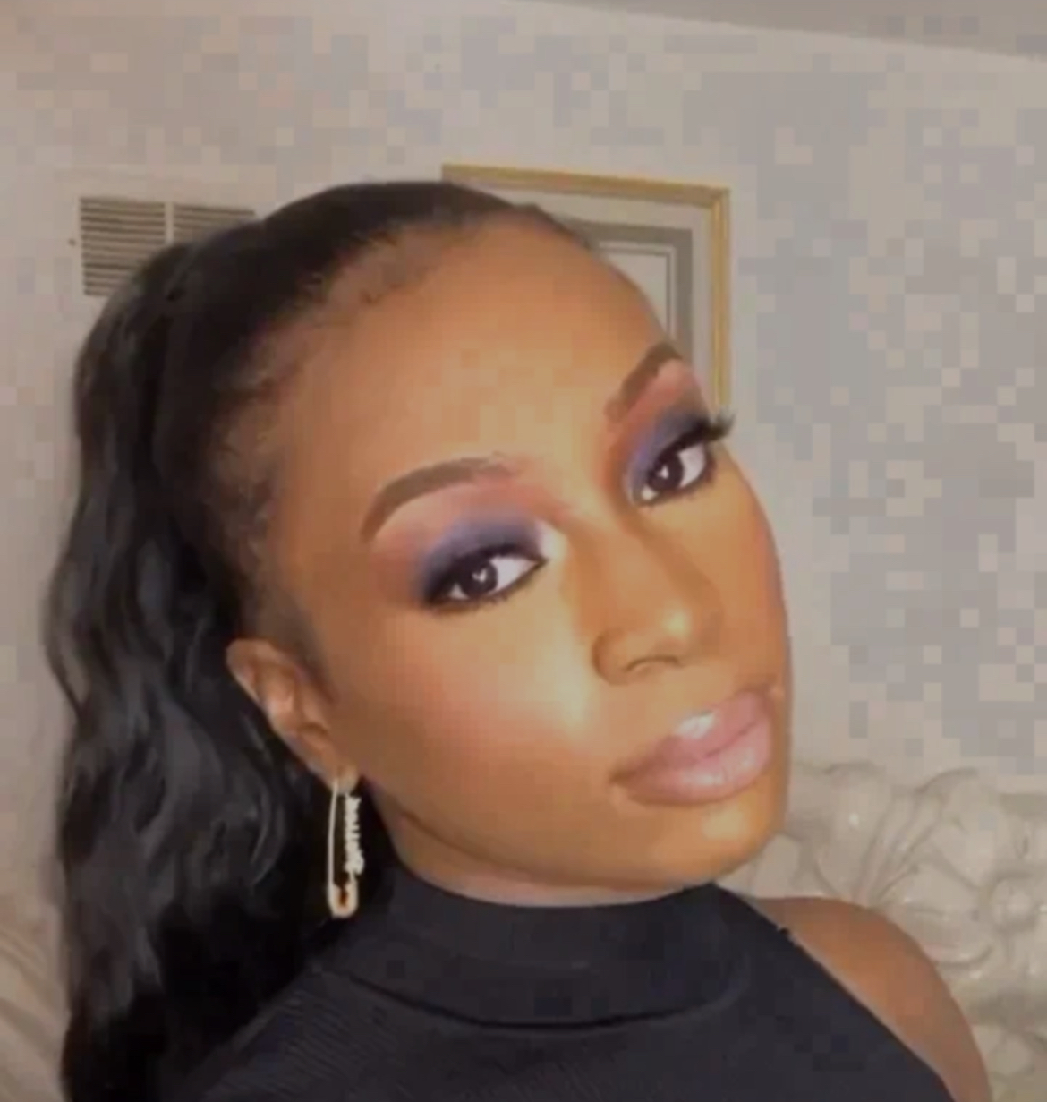
Team Introductions
Milcla
Dua'a
Jeremiah
Adesuwa

Slide 3
Meta Retargeting KPIs
Notes:
As we know we want to keep our CPA and CPC low and in both quarters the reptile campaigns had those in high numbers.

Slide 4
Reptile Campaigns
Least Performing Campaigns
Campaign | CPA | CPC | CTR | CVR
MetaRetarget_Q1_Reptile | $1,050.61 | $29.09 | 3% | 80%
MetaRetarget_Q2_Reptile | $1,046.23 | $23.69 | 4% | 30%
MetaRetarget_Q2_Fish | $295.90 | $13.34 | 6% | 59%
Least Cost Efficient Campaigns | ROI
MetaRetarget_Q1_Reptile | $2.88
MetaRetarget_Q2_Reptile | $3.56
MetaRetarget_Q2_Cat | $12.55
Campaign Name | Sum of Orders
Q1 Bird | 10431
Q1 Cat | 21837
Q1 Dog | 39426
Q1 Fish | 5830
Q1 Reptile | 2417
Q2 Bird | 9564
Q2 Cat | 20756
Q2 Dog | 37144
Q2 Fish | 4889
Q2 Reptile | 1008
Grand Total | 153302
Notes:
The Reptile campaigns had the least amount of orders and in return not being the most cost efficient. Looking over the KPIs they were also low performing as well.

Slide 5
Meta Retargeting Cost Efficiency
Most Cost Efficient Campaigns | ROI
MetaRetarget_Q1_Dog | $41.34
MetaRetarget_Q2_Dog | $36.43
MetaRetarget_Q2_Bird | $17.09
Least Cost Efficient Campaigns | ROI
MetaRetarget_Q1_Reptile | $2.88
MetaRetarget_Q2_Reptile | $3.56
MetaRetarget_Q2_Cat | $12.55
Notes:
When look at the how much we spent and how much we received back, Q1 and Q2 for dogs gave us the most ROI.

Slide 6
Quarterly Overview of Meta Retarget
Campaign Name | Sum of ROI
Q1 Bird | $16.41
Q1 Cat | $12.72
Q1 Dog | $41.34
Q1 Fish | $14.95
Q1 Reptile | $2.88
Grand Total | $22.97
Campaign Name | Sum of ROI
Q2 Bird | $17.09
Q2 Cat | $12.55
Q2 Dog | $36.43
Q2 Fish | $16.54
Q2 Reptile | $3.56
Grand Total | $21.96

Slide 7
Overall Campaign Insights
Top Performers: The Q1 and Q2 Dog campaigns were the most cost-efficient and top overall performers.
By Quarters: Q1 had the most amount of Revenue ($24,927,579.79) which showed improved cost efficiency compared to Q2 by approximately $1.
Reptile Campaigns: The Meta Retarget Reptile campaigns were the least cost-efficient and worst-performing, with low order volume.
Recommendation: Discontinue the Reptile campaigns and reallocate the budget to the Dog campaigns for better performance and cost efficiency.
Campaign Name | Sum of Spend | Sum of Clicks | Sum of Impressions | Sum of Orders | Sum of Revenue
FY24_MetaRetarget_Q1_Bird | $172,941.55 | 373,584 | 18,246,035 | 10,431 | $2,838,554.64
FY24_MetaRetarget_Q1_Cat | $345,301.43 | 557,033 | 67,859,496 | 21,837 | $4,390,714.04
FY24_MetaRetarget_Q1_Dog | $384,679.17 | 915,517 | 58,329,223 | 39,426 | $15,903,605.45
FY24_MetaRetarget_Q1_Fish | $105,181.35 | 123,197 | 26,538,416 | 5,830 | $1,572,539.85
FY24_MetaRetarget_Q1_Reptile | $77,188.36 | 35,101 | 12,097,314 | 2,417 | $222,165.81
FY24_MetaRetarget_Q2_Bird | $178,554.68 | 390,628 | 19,816,941 | 9,564 | $3,050,932.15
FY24_MetaRetarget_Q2_Cat | $343,506.09 | 708,099 | 62,830,877 | 20,756 | $4,311,916.15
FY24_MetaRetarget_Q2_Dog | $420,905.79 | 991,199 | 65,692,371 | 37,144 | $15,332,184.00
FY24_MetaRetarget_Q2_Fish | $106,604.17 | 114,139 | 26,889,211 | 4,889 | $1,763,533.04
FY24_MetaRetarget_Q2_Reptile | $76,924.47 | 49,006 | 15,234,338 | 1,008 | $273,639.41
Grand Total | $2,211,787.06 | 4,257,504 | 373,534,221 | 153,302 | $49,659,784.53

Slide 8
Quarterly Overview of SEM Conquest
Campaign Name | Spend Total | Revenue Total | ROI
SEMC_Q1_Bird | $9,037 | $156,277 | $17.29
SEMC_Q1_Cat | $13,636 | $324,878 | $23.82
SEMC_Q1_Dog | $12,037 | $377,938 | $31.40
SEMC_Q1_Fish | $5,168 | $51,182 | $9.90
Grand Total | $39,877 | $910,275 | $22.83
Campaign Name | Spend Total | Revenue Total | ROI
SEMC_Q2_Bird | $9,066 | $148,561 | $16.39
SEMC_Q2_Cat | $11,902 | $317,974 | $26.72
SEMC_Q2_Dog | $13,864 | $489,805 | $35.33
SEMC_Q2_Fish | $6,005 | $37,870 | $6.31
Grand Total | $40,837 | $994,210 | $24.35
Q2 outperformed Q1 with $1.52 over Q1's ROI and over $80,000 difference in revenue across both quarters.

Slide 9
Campaign Overview of SEM Conquest
Campaign Name | Sum of Spend | Sum of Revenue
FY24_SEM_Q1_Bird | $9,036.99 | $156,276.90
FY24_SEM_Q1_Cat | $13,636.16 | $324,878.21
FY24_SEM_Q1_Dog | $12,036.60 | $377,938.10
FY24_SEM_Q1_Fish | $5,167.67 | $51,181.99
FY24_SEM_Q2_Bird | $9,066.09 | $148,560.84
FY24_SEM_Q2_Cat | $11,901.84 | $317,973.84
FY24_SEM_Q2_Dog | $13,864.01 | $489,805.17
FY24_SEM_Q2_Fish | $6,005.07 | $37,870.19
Grand Total | $80,714.44 | $1,904,485.25
Campaign Name | CPC | CPA | CVR | CTR | ROI
FY24_SEM_Q1_Bird | $2.34 | $9.26 | 25.31% | 0.31% | $17.29
FY24_SEM_Q1_Cat | $4.32 | $6.54 | 66.08% | 0.31% | $23.82
FY24_SEM_Q1_Dog | $1.82 | $4.88 | 37.34% | 0.71% | $31.40
FY24_SEM_Q1_Fish | $2.89 | $3.87 | 74.82% | 0.14% | $9.90
FY24_SEM_Q2_Bird | $2.48 | $9.85 | 25.17% | 0.39% | $16.39
FY24_SEM_Q2_Cat | $5.96 | $6.05 | 98.49% | 0.33% | $26.72
FY24_SEM_Q2_Dog | $1.51 | $4.86 | 31.02% | 1.02% | $35.33
FY24_SEM_Q2_Fish | $5.44 | $6.25 | 87.09% | 0.08% | $6.31

Slide 10
SEM Conquest Performance and Efficiency
Best Performing Campaign Statistics
Campaign Name | CPC | CPA | CVR | CTR
Q2 Dog Campaign | $1.51 | $4.86 | 31.02% | 1.02%
Q1 Dog Campaign | $1.82 | $4.88 | 37.34% | 0.71%
Q2 Cat Campaign | $5.96 | $6.05 | 98.49% | 0.33%
Campaign Name | CPC | CPA | CVR | CTR | ROI
FY24_SEM_Q1_Bird | $2.34 | $9.26 | 25.31% | 0.31% | $17.29
FY24_SEM_Q1_Cat | $4.32 | $6.54 | 66.08% | 0.31% | $23.82
FY24_SEM_Q1_Dog | $1.82 | $4.88 | 37.34% | 0.71% | $31.40
FY24_SEM_Q1_Fish | $2.89 | $3.87 | 74.82% | 0.14% | $9.90
FY24_SEM_Q2_Bird | $2.48 | $9.85 | 25.17% | 0.39% | $16.39
FY24_SEM_Q2_Cat | $5.96 | $6.05 | 98.49% | 0.33% | $26.72
FY24_SEM_Q2_Dog | $1.51 | $4.86 | 31.02% | 1.02% | $35.33
FY24_SEM_Q2_Fish | $5.44 | $6.25 | 87.09% | 0.08% | $6.31
Worst Performing Campaign Statistics
Campaign Name | CPC | CPA | CVR | CTR
Q2 Fish Campaign | $5.44 | $6.25 | 87.09% | 0.08%
Q2 Bird Campaign | $2.48 | $9.85 | 25.17% | 0.39%
Q1 Fish Campaign | $2.89 | $3.87 | 74.82% | 0.14%
To determine cost efficiency and performance, the measured KPIs were used as a baseline for comparison across all campaigns. Based on KPI outcomes, it was determined that the most cost efficient and best performing campaigns were both Dog Campaigns and Q2 Cat campaign, while the least cost efficient and worst performing were both Fish Campaigns and Q2 Bird Campaign.

Slide 11
SEM Conquest Fish Campaign
Across both quarters of the SEM-C campaign, the Fish campaign has done the worst. It generated the least amount of revenue for both quarters, and while they did have some highlights such as higher CVRs, the KPIs show that they have done rather poorly everywhere else.
The suggestion stands to suspend the SEM-C Fish Campaign and instead divert it to the other campaigns that have performed higher, such as the Dog Campaign or Cat campaign.
Campaign | ROI
SEMC_Q1 Bird | $17.29
SEMC_Q1 Cat | $23.82
SEMC_Q1 Dog | $31.40
SEMC_Q1 Fish | $9.90
SEMC_Q2 Bird | $16.39
SEMC_Q2 Cat | $26.72
SEMC_Q2 Dog | $35.33
SEMC_Q2 Fish | $6.31

Slide 12
Overall SEM-Conquest Campaign Insights
Campaign Name | Clicks | Impressions | Orders
FY24_SEM_Q1_Bird | 3,856 | 1,234,298 | 976
FY24_SEM_Q1_Cat | 3,154 | 1,011,059 | 2,084
FY24_SEM_Q1_Dog | 6,612 | 933,558 | 2,469
FY24_SEM_Q1_Fish | 1,787 | 1,299,629 | 1,337
FY24_SEM_Q2_Bird | 3,656 | 944,902 | 920
FY24_SEM_Q2_Cat | 1,998 | 609,177 | 1,968
FY24_SEM_Q2_Dog | 9,205 | 903,952 | 2,855
FY24_SEM_Q2_Fish | 1,103 | 1,451,163 | 961
Grand Total | 31,371 | 8,387,738 | 13,570
Top Performers: Dog Campaigns performed the best out of all operating SEM-C campaigns and overall were the most cost efficient, with Cat Campaigns following close behind
Quarterly: Q2 SEM-C Campaign outperformed Q1 with over $80,000 in revenue and $1.52 difference in ROI
Fish Campaign Insights: Across both quarters, the Fish Campaigns were the lowest performing and the least cost efficient, generating the lowest revenue across the campaign.
Recommendations: Suggested to suspend the Fish SEM-C campaign due to inefficiency and low performance, and divert budget to the Dog or Cat campaigns since they are the highest performers and will improve cost efficiency and performance.
Campaign Name | Sum of Spend | Sum of Revenue
FY24_SEM_Q1_Bird | $9,036.99 | $156,276.90
FY24_SEM_Q1_Cat | $13,636.16 | $324,878.21
FY24_SEM_Q1_Dog | $12,036.60 | $377,938.10
FY24_SEM_Q1_Fish | $5,167.67 | $51,181.99
FY24_SEM_Q2_Bird | $9,066.09 | $148,560.84
FY24_SEM_Q2_Cat | $11,901.84 | $317,973.84
FY24_SEM_Q2_Dog | $13,864.01 | $489,805.17
FY24_SEM_Q2_Fish | $6,005.07 | $37,870.19
Grand Total | $80,714.44 | $1,904,485.25

Slide 13
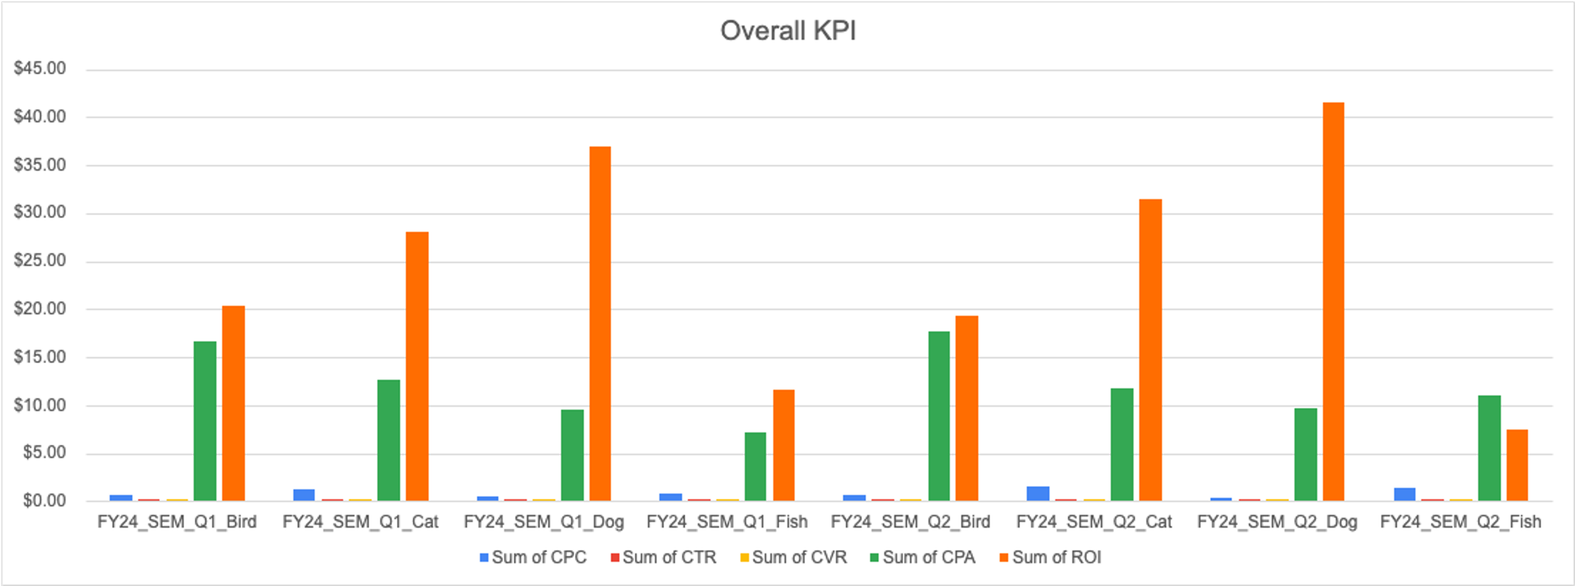
SEM KPI's
Notes:
Average CPC: $0.71, demonstrating cost-effective click acquisition.
Average CTR: 1.73%, showing good engagement rates across campaigns.
Average CVR: 6.2%, with efficient conversion performance.
Average CPA: $11.38, highlighting low acquisition costs.
Overall ROI: $27.76

Slide 14
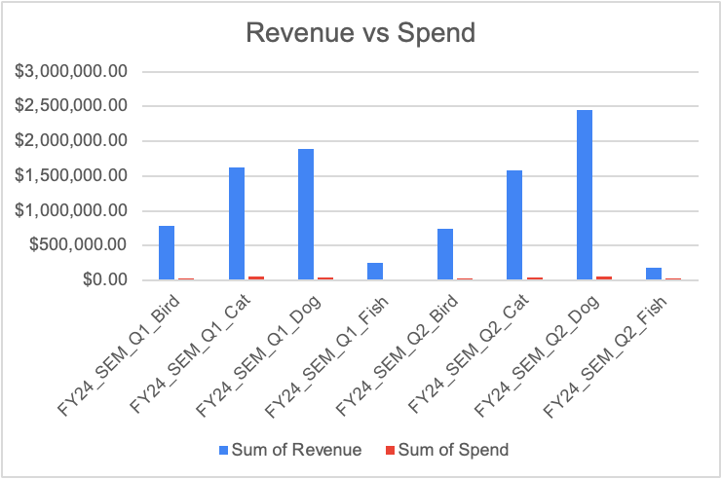
Campaign Overview
The Dog campaign stands out as the most profitable and cost-efficient, with the highest overall revenue and revenue-to-spend ratio across both quarters.
The Fish campaign consistently shows the lowest revenue and revenue efficiency, indicating potential underperformance in both quarters.

Slide 15
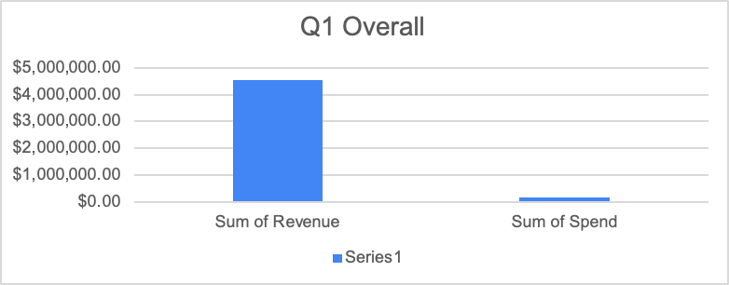
Quarterly Overview
The Dog campaign increased its revenue to $2.45M, further establishing itself as the top performer.
The Fish campaign had a significant drop in both revenue and performance, with the lowest total revenue in Q2 ($189.3K)

Slide 16
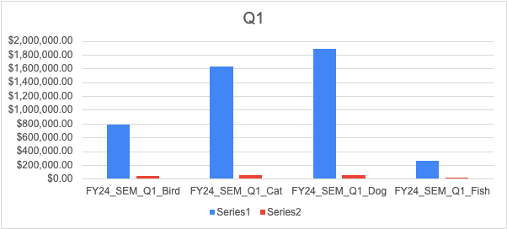
Quarterly Overview
Campaign Q1 | Sum of Revenue | Sum of Spend
FY24_SEM_Q1_Bird | $781,384.52 | $38,407.21
FY24_SEM_Q1_Cat | $1,624,391.04 | $57,953.68
FY24_SEM_Q1_Dog | $1,889,690.52 | $51,155.53
FY24_SEM_Q1_Fish | $255,909.93 | $21,962.61
Campaign Q2 | Sum of Revenue | Sum of Spend
FY24_SEM_Q2_Bird | $742,804.19 | $38,530.87
FY24_SEM_Q2_Cat | $1,589,869.22 | $50,582.83
FY24_SEM_Q2_Dog | $2,449,025.87 | $58,922.05
FY24_SEM_Q2_Fish | $189,350.95 | $25,521.57
The Dog and Cat campaigns are top drivers of revenue and should continue to be prioritized and optimized for future quarters. The Fish campaign may require a reevaluation of strategy or resources to improve its performance.

Slide 17
Cost Efficiency
Top 3 Best ROI
FY24_SEM_Q2_Dog | $41.56
FY24_SEM_Q1_Dog | $36.94
FY24_SEM_Q2_Cat | $31.43
Top 3 Worst ROI
FY24_SEM_Q2_Fish | $7.42
FY24_SEM_Q1_Fish | $11.65
FY24_SEM_Q2_Bird | $19.28
The Dog campaign was the top performer in terms of cost efficiency, generating $4.34M in revenue on a total spend of $110K
The Cat campaign also showed excellent cost-efficiency, generating $3.21M in revenue with a total spend of $108.5K
The Fish campaign was the least cost-efficient, generating only $445K in revenue on a spend of $47.5K

Slide 18
Key Insights
Key Insights & Callouts Overview
High Revenue and Efficiency from Dog campaign
Moderate Returns for Bird Campaign
The Fish campaign underperformed relative to the others
Key Callouts
Dog and Cat campaigns: These campaigns should receive increased attention and possibly more budget, as they have demonstrated strong cost-efficiency.
Bird campaign its lower budget may be limiting its potential
The Fish campaign is clearly struggling compared to the others. A deeper analysis of its strategy is needed

Slide 19
Overall Meta Awareness Performance

Slide 20
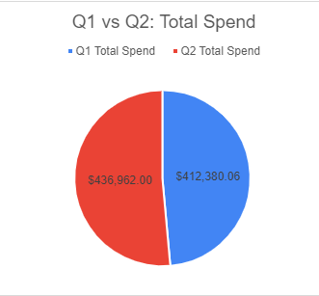
Total Spend Analysis
Total Spend Across Quarters
Q1 Total Spend: $412,280.06
Q2 Total Spend: $437,062.00
Callout: Q2 spending increased by 6% over Q1, but efficiency must be assessed.

Slide 21
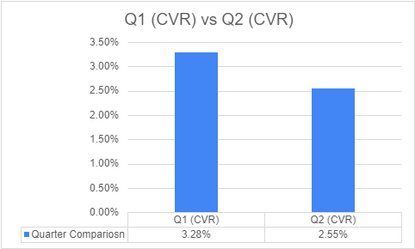
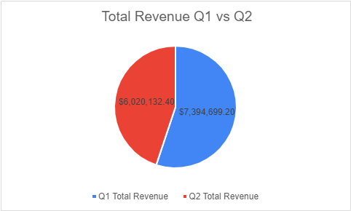
New Users & Impact on Orders/Revenue
Impact on Traffic, Orders & Revenue
Q1 campaigns were better at converting clicks into orders essentially bringing in more revenue.
Q1 drove more orders and revenue, indicating better effectiveness in converting users into customers.
New Users Driven: Q1 vs Q2
Q1 Total Orders: 28,651
Q2 Total Orders: 20,177
Revenue & Order Impact:
Q1: $7.4M | Q2: $6M

Slide 22
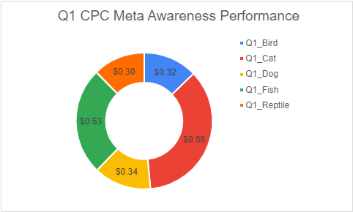
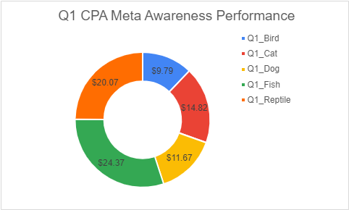
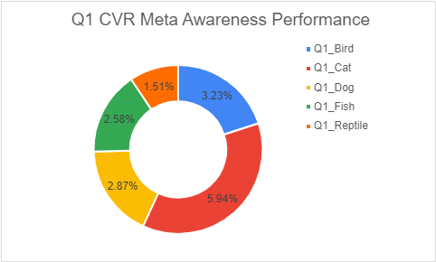
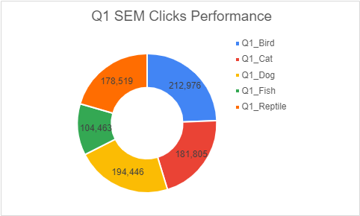
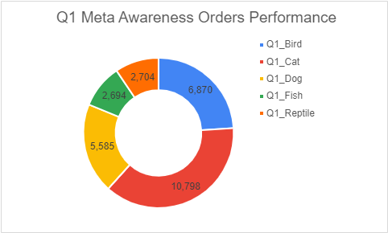
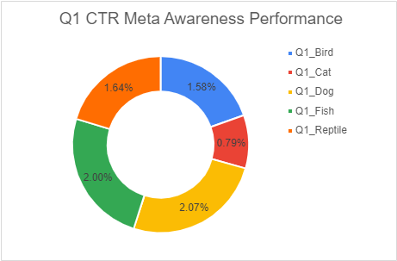
Q1 Strengths and Weaknesses
Q1 Strength: Lower cost per click, indicating more efficient spending to drive traffic.
Q1 Strength: Lower CPA means more cost-effective in driving conversions (acquisitions).
Q1 Strength: Higher CVR suggests better conversion of traffic to orders, indicating more effective campaigns.
Q1 Strength: More clicks, suggesting better overall engagement with ads.
Q1 Strength: Higher number of orders, showing better overall campaign performance in generating conversions.
Q1 Weakness: Slightly lower CTR, possibly indicating less engagement with ads compared to Q2.

Slide 23
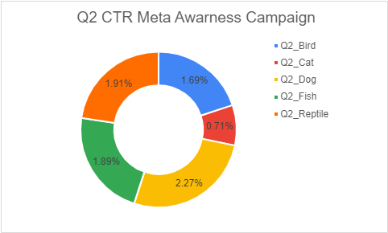
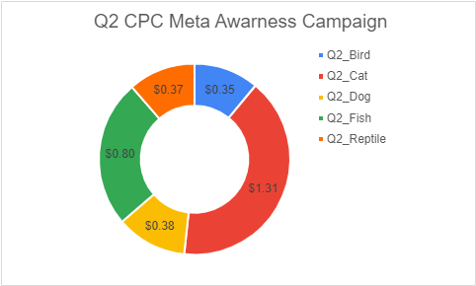
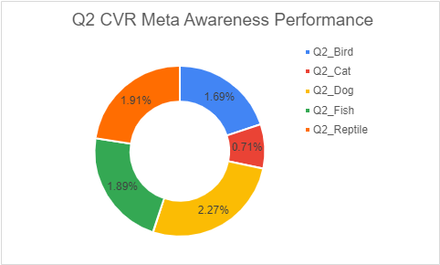
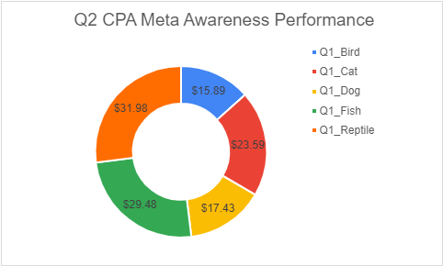
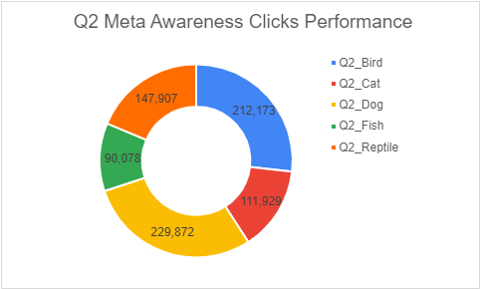
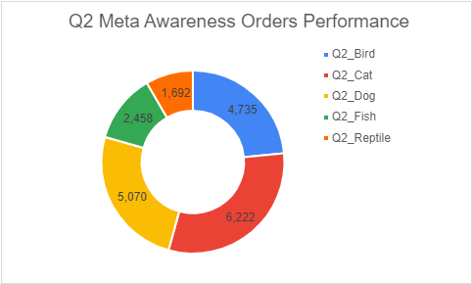
Q2 Strengths and Weaknesses
Q2 Strength: Higher engagement with ads, showing better targeting or creative performance.
Q2 Weakness: Higher CPC means campaigns are less cost-efficient in acquiring clicks.
Q2 Weakness: Higher CPA, making Q2 less efficient in driving conversions.
Q2 Weakness: Lower CVR, meaning fewer conversions relative to the number of clicks.
Q2 Weakness: Fewer clicks, indicating a drop in user interest or reach.
Q2 Weakness: Fewer orders, meaning campaigns were less successful in converting clicks to sales.

Slide 24
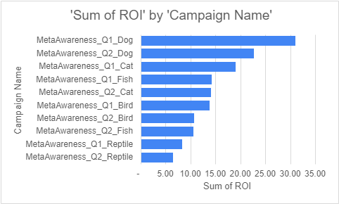
Top 3 Best-Performing
Top 3 Best-Performing Campaigns
Campaign | ROI | CPC | CTR | CPA
Q1 Dog | $30.99 | $0.34 | 2.07% | $11.67
Q1 Cat | $19.07 | $0.88 | 0.79% | $14.82
Q2 Dog | $22.67 | $0.38 | 2.27% | $17.43
#1 Q1 Dog Campaign:
Best ROI of $30.99
Low CPC of $0.34
Solid CTR of 2.07%
#2 Q1 Cat Campaign
ROI of $19.07
Despite their low CTR (0.79%) they have the Highest CVR of 5.94%
#3 Q2 Dog Campaign
Strong ROI of $22.67 with improved CTR (2.27%)
Callout: Scale these campaigns for higher returns. Focus on Dog and Cat campaigns for consistent performance.​

Slide 25
Top 3 Best-Performing
Top 3 Underperforming-Performing Campaigns
Campaign | ROI | CPA | CVR | CTR
Q2 Reptile | $6.47 | $31.98 | 1.14% | 1.91%
Q1 Reptile | $8.33 | $20.07 | 1.51% | 1.64%
Q2 Fish | $14.34 | $24.37 | 2.58% | 2.00%
#1 Q2 Reptile:
Lowest ROI of $6.47
High CPA ($31.98)
Low CVR (1.14%)
#2 Q1 Reptile Campaign
Low ROI of $8.33
High CPA ($20.07)
#3 Q2 Fish Campaign
Lower ROI of $14.34
CPA of $24.37
Callout: Consider scaling back or optimizing these campaigns—high costs and low returns.

Slide 26
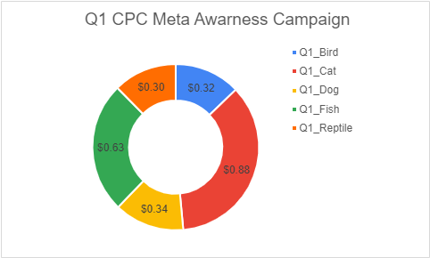
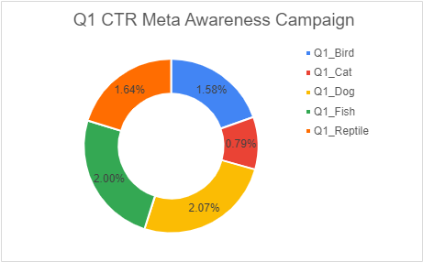
Best Quarter for CPC, CTR, and Cost Efficiency
Metric | Q1 | Q2 | Best Quater
CPC | $0.49 | $064 | Q1
CTR | 1.61% | 1.73% | Q2
CPA | $14.94 | $23.27 | Q1
CVR | 2.77% | 2.37% | Q1
Callout: Q1 wins on efficiency (lower CPC, CPA, and higher CVR).

Slide 27
Meta Awareness Campaigns Performance Overview
Key Insights & Recommendations

Slide 28
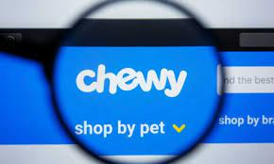
Overall Performance Trends
Quarter | Average CPC | Average CPA | Average ROI
Q1 | $0.49 | $14.94 | $17.71
Q2 | $0.64 | $23.27 | $12.15
Callout: Q1 is generally more cost-efficient than Q2. Replicate Q1 strategies for future success.

Slide 29
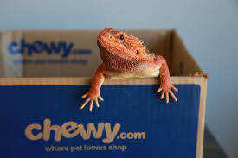
Are We Driving Long-Term Value Here at Chewy?
Reptile Campaign Impact:
Top-of-funnel traffic: Strong, but conversion is weak.
Long-term value potential: Low unless optimized.
Callout: Reassess or redesign Reptile campaign to better engage users or reduce spend.

Slide 30
Key Recommendations
Scale high-performing campaigns: Dog (Q1 & Q2), Cat (Q1)
Optimize or reduce spending: Reptile (Q1 & Q2), Fish (Q1)
Refine audience targeting & engagement for underperforming campaigns
Focus on ROI: Invest in campaigns that balance CTR, CPC, and conversion rates
Notes:
Next Action: Adjust budget allocations, target optimizations, and creative based on performance data.

Slide 31
Budget Spend
Q1 Budget Forecast (Media Budget)
 | Bird | Cat | Dog | Fish | Reptile | Total
SEM | $40,000.00 | $55,000.00 | $50,000.00 | $25,000.00 |  | $170,000.00
SEM (Conquest) | $10,000.00 | $12,000.00 | $12,000.00 | $6,000.00 |  | $40,000.00
Social (Awareness) | $180,000.00 | $350,000.00 | $380,000.00 | $120,000.00 | $80,000.00 | $1,110,000.00
Social (Retargeting) | $80,000.00 | $150,000.00 | $60,000.00 | $70,000.00 | $60,000.00 | $420,000.00
Totals | $310,000.00 | $567,000.00 | $502,000.00 | $221,000.00 | $140,000.00 | $1,740,000.00
Q1 Budget Actuals This is the actual campaigns spend during Q1
 | Bird | Cat | Dog | Fish | Reptile | Total
SEM | $38,407.21 | $57,953.68 | $51,155.53 | $21,962.61 |  | $169,479.04
SEM (Conquest) | $9,036.99 | $13,636.16 | $12,036.60 | $5,167.67 |  | $39,877.42
Social (Awareness) | $67,290.51 | $159,985.89 | $65,170.91 | $65,651.26 | $54,281.49 | $412,380.06
Social (Retargeting) | $172,941.55 | $345,301.43 | $384,679.17 | $105,181.35 | $77,188.36 | $1,085,291.86
Totals | $287,676.26 | $576,877.16 | $513,042.21 | $197,962.89 | $131,469.85 | $1,707,028.38
Q2 Budget Forecast (Media Budget)
 | Bird | Cat | Dog | Fish | Reptile | Total
SEM | $40,000.00 | $45,000.00 | $55,000.00 | $30,000.00 |  | $170,000.00
SEM (Conquest) | $10,000.00 | $12,000.00 | $15,000.00 | $5,000.00 |  | $42,000.00
Social (Awareness) | $180,000.00 | $340,000.00 | $420,000.00 | $110,000.00 | $80,000.00 | $1,130,000.00
Social (Retargeting) | $76,000.00 | $140,000.00 | $88,000.00 | $75,000.00 | $60,000.00 | $439,000.00
Totals | $306,000.00 | $537,000.00 | $578,000.00 | $220,000.00 | $140,000.00 | $1,781,000.00
Q2 Budget Actuals (Hint: This is the actual campaigns spend during Q2)
 | Bird | Cat | Dog | Fish | Reptile | Total
SEM | $38,530.87 | $50,582.83 | $58,922.05 | $25,521.57 |  | $173,557.32
SEM (Conquest) | $9,066.09 | $11,901.84 | $13,864.01 | $6,005.07 |  | $40,837.02
Social (Awareness) | $75,244.80 | $146,784.00 | $88,368.40 | $72,452.80 | $54,112.00 | $436,962.00
Social (Retargeting) | $178,554.68 | $343,506.09 | $420,905.79 | $106,604.17 | $76,924.47 | $1,126,495.20
Totals | $301,396.44 | $552,774.76 | $582,060.25 | $210,583.61 | $131,036.47 | $1,777,851.53

Slide 33
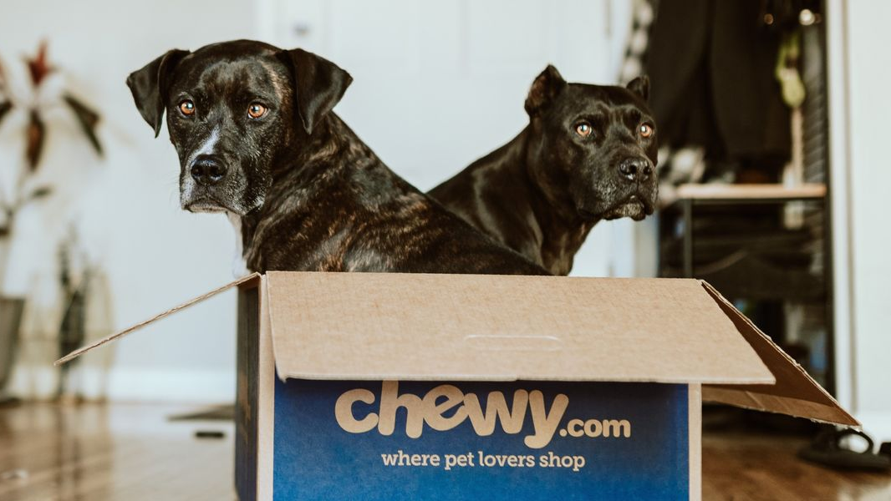
Thank you! Questions?

